Slide 1
Data Science Project

Slide 2
Team members:
Mekhail Samy Lotfy(2021170563)
Sara Osama Raouf (2021170222)
Sandra George Samir(2021170229)
Mina Nasser Wanas(2021170570)
Mina Nashaat Ayoub(2021170571)
Mina Romany Fawzi(2021170567)

Slide 3
Introduction:
Problem: we are tackling a binary image classification problem where the goal is to distinguish between two classes: dogs and spiders. Given the diverse appearance of these objects in real-world scenarios, the task requires models capable of recognizing complex patterns and features in the images. The challenge lies in handling the variations in lighting, background, orientation, and other conditions that might affect the appearance of the objects.

Slide 4
Introduction:
Idea: The project focuses on implementing two different approaches for image classification , from scratch model and a pre-trained model.
The first approach involves designing a convolutional neural network (CNN) specifically tailored for this problem, using layers such as convolutional layers, pooling, and fully connected layers to extract meaningful features and perform classification.
The second approach uses a pre-trained model (VGG16), a well-known deep CNN that has been pre-trained on a large dataset.

Slide 5
From scratch Model

Slide 6
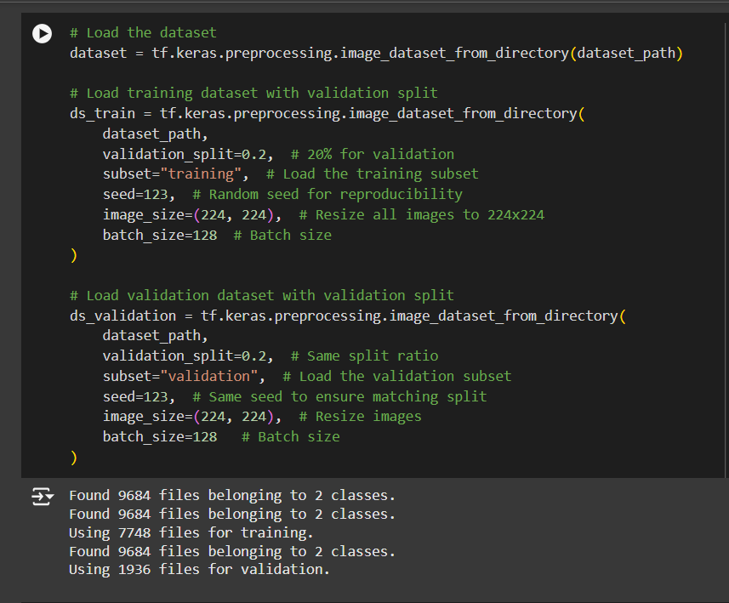
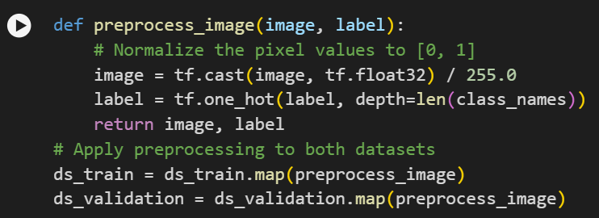
Dataset description and preprocessing

Slide 7
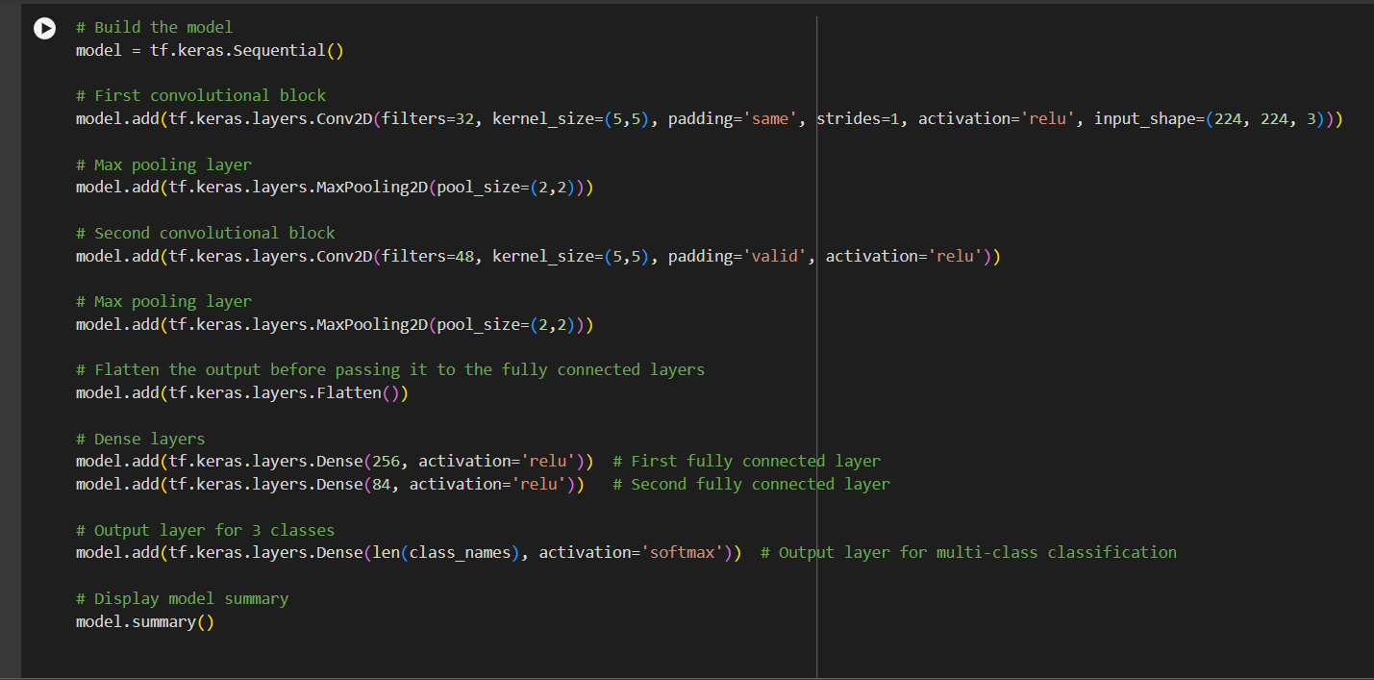
Models:

Slide 8
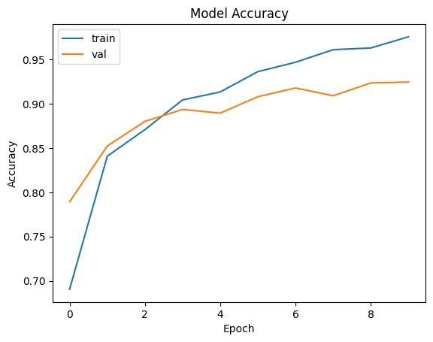
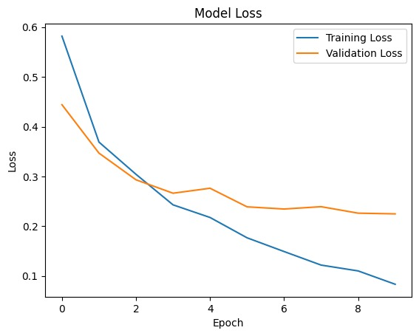
Results and Conclusion:

Slide 9
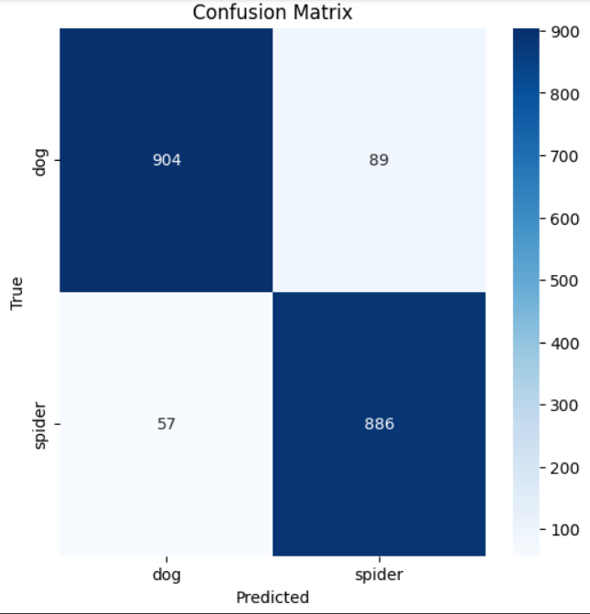
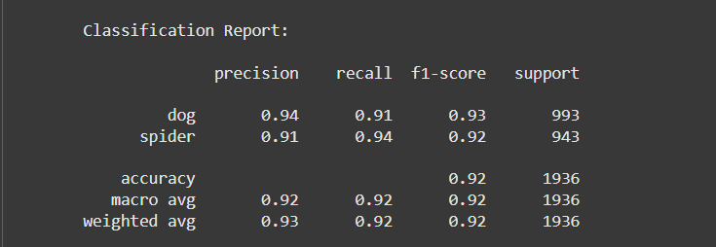
Results and Conclusion

Slide 10
Pre trained Model

Slide 11
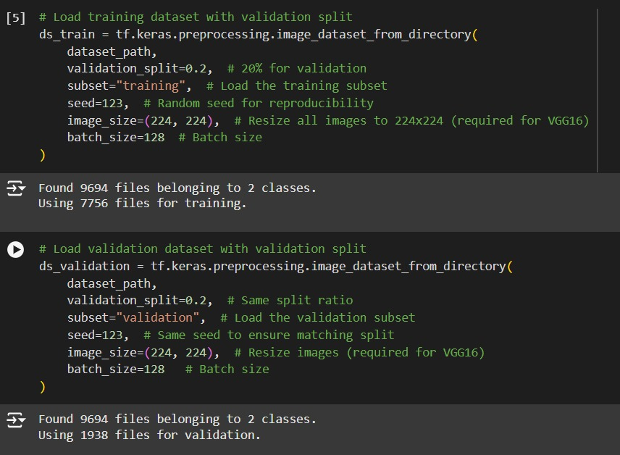
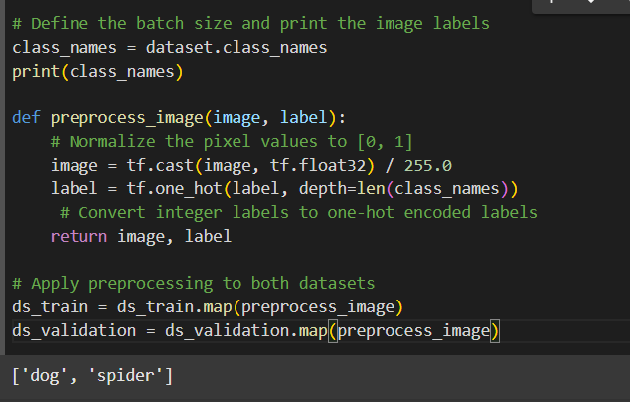
Dataset description and preprocessing

Slide 12
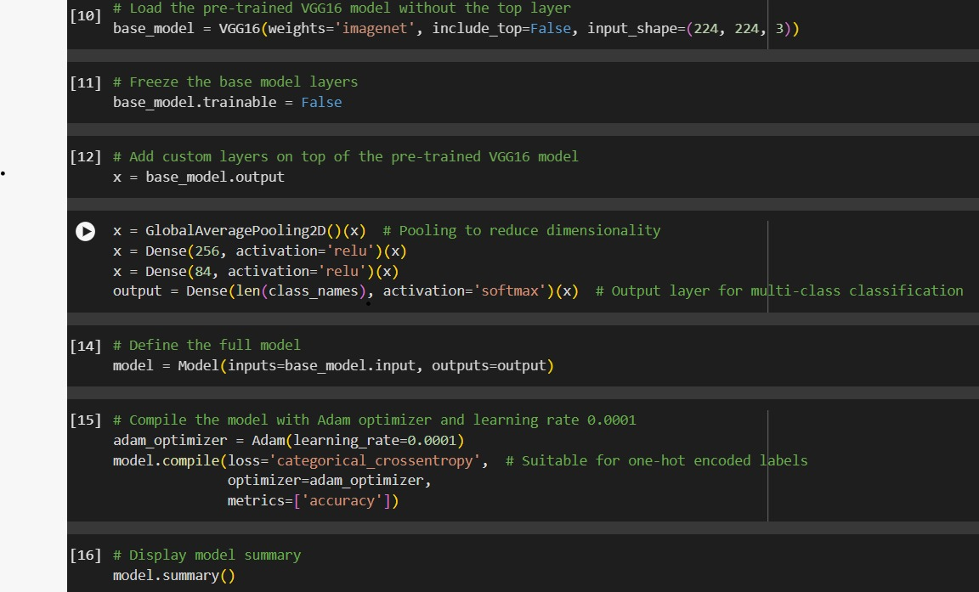
Models:

Slide 13
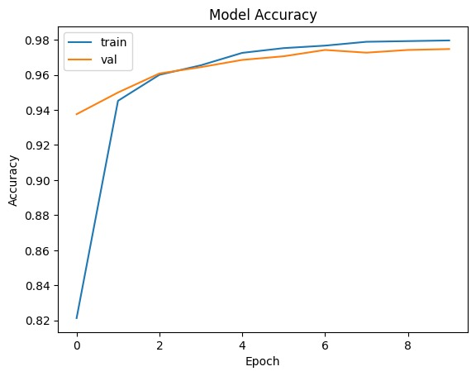
Results and Conclusion:

Slide 14
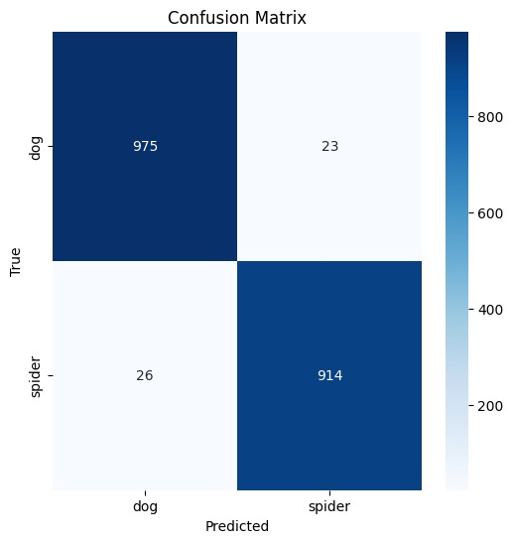
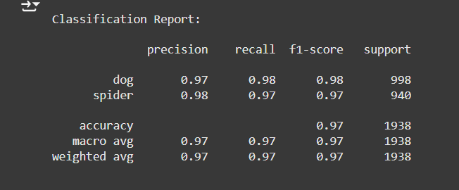
Results and Conclusion:

